Slide 1
Aquatechnics
Building Community in Public Spaces
Francois Chu | Jessa Hafer-Zdral | Emily Vincent | JD Vogt

Slide 2
Problem
Support activities within a public landscape using an interactive kiosk
Utilize environmental sensors to adapt to the current conditions of the site
Notes:
Talked about buses stops,

Slide 3
Where can we add?
Street Nightlife
Shopping Mall
Concert Hall
Park
Bus Stop
Hospital
Subway
Flea Market
Street Performer
Historic Walk
Strip District
Notes:
Considered a lot of places
Really latched onto something that would help build community, something that would bring people together

Slide 4
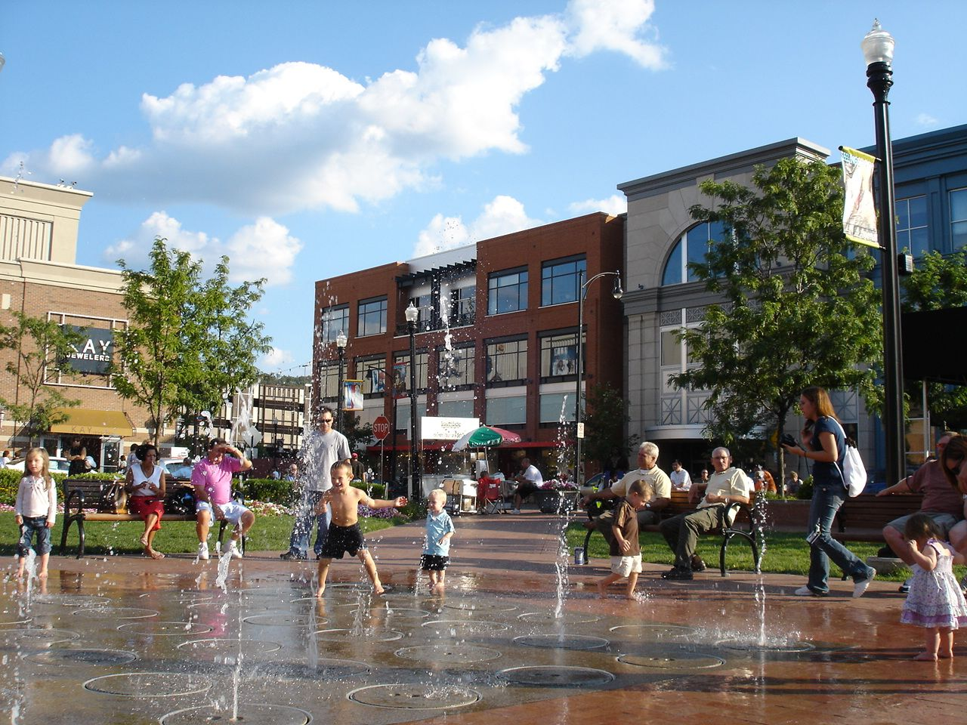
Southside Works
Notes:
Fountain at the southside works – already brings people together (waiting, resting, playing, concerts)
Wanted to turn it into an interactive experience – get the people to interact
Becomes destination

Slide 5
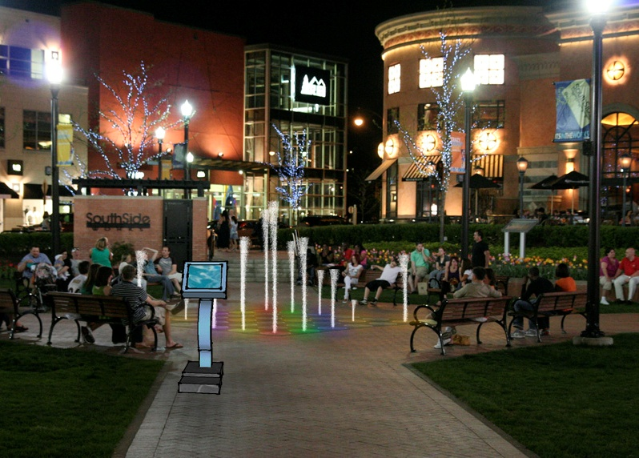
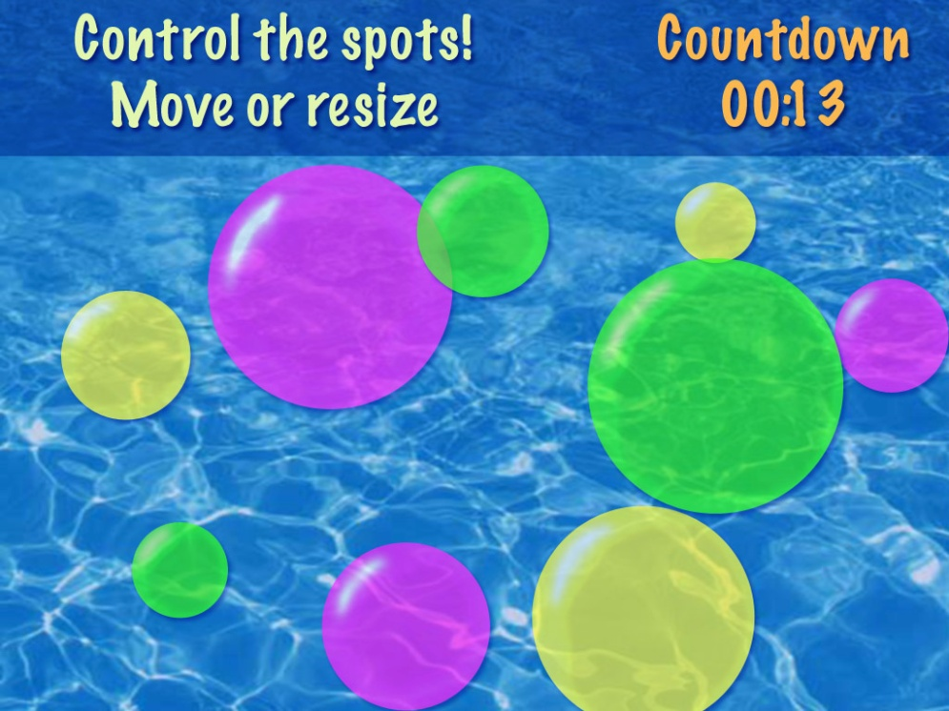
Aquatechnics
Notes:
So we created Aquatechnics
Entertains and interacts with the people around it
Tries to engage them with it and other people
So how did we get here?

Slide 6
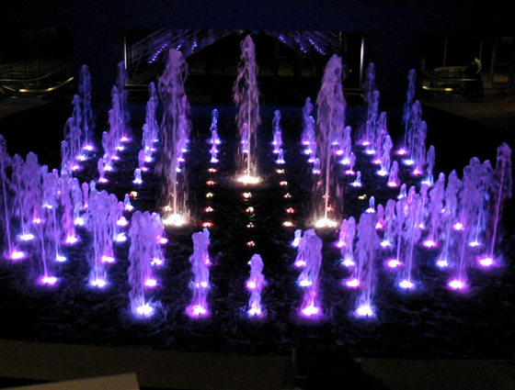
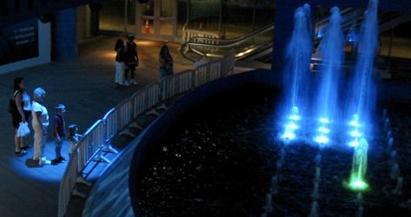
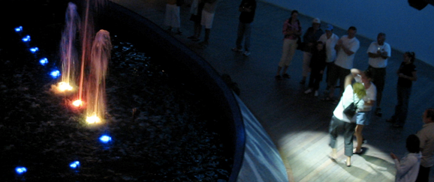
Online Research
Notes:
Started online b/c it was too cold for fountains in pittsburgh to be on
Saw a lot of fountains that entertained
Atlantic city – follows people, tries to get them to dance

Slide 7
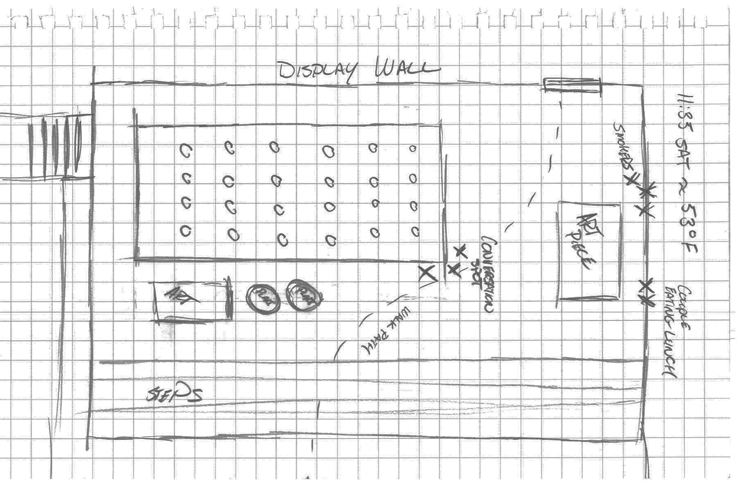
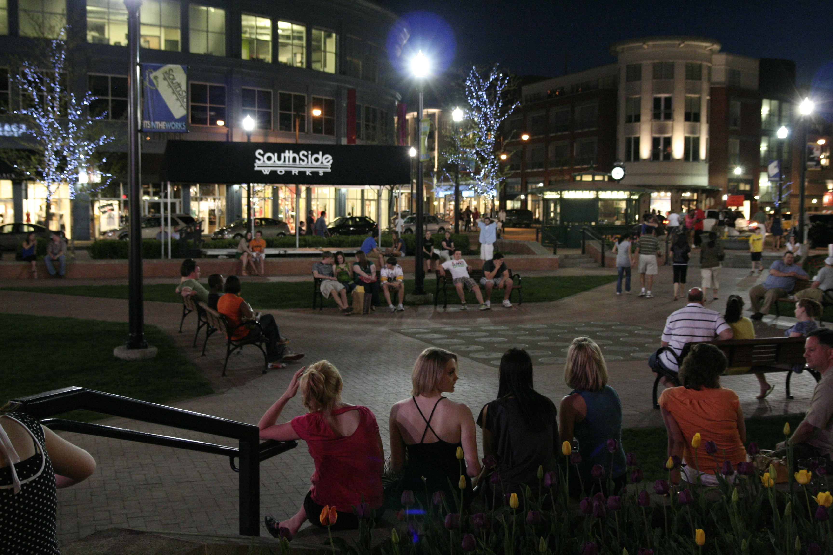
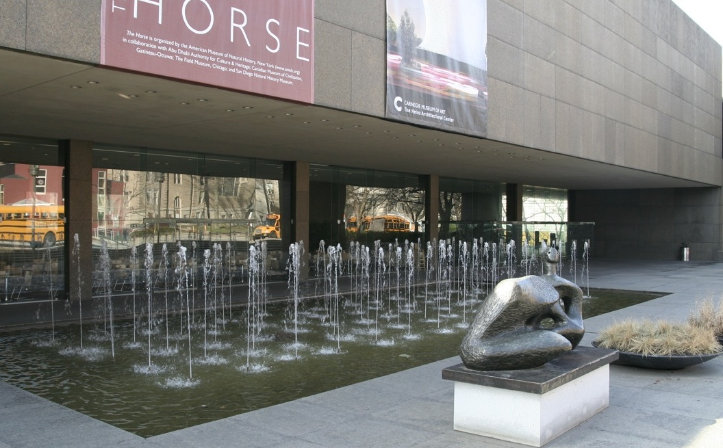
Direct Observation
Notes:
Carnegie Museum – pretty dark, doesn’t invite playing
Found that people really didn’t stop by it, weren’t attracted to it
Phipps – interactive fountain. Children loved it, played together on it. Interface was really hard. Adults got self-concious.

Slide 8
Concept Generation
Games
duck duck goose
musical chairs
Twister
red rover
Musical spots
Rock band displayed on building next door
Flash mobs and event creation
Recognizing regulars
Stimulus response training
Direct play and record
Morning sounds
peaceful
birds
Point jets in specific directions
(directions or funny directions)‏
Golf sprinkler
(everyone wet)‏
Romantic place to create memories (book it for 5 min)
Water invites engagement by moving towards and away
Get in line
Musical group / weekend concert
choreograph water in time with dance group/band
Random splashes
Drunk fountain
Homeless washing
Drinking fountain
Personality & mood bar
Notes:
What we thought we could do to bring people there

Slide 9
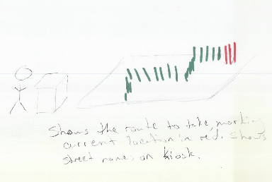
In Class Speed Dating
Notes:
Two we really liked that flopped – Directions & Notifications

Slide 10
Onsite Speed Dating
Notes:
Younger people liked idea of play with/in fountain
Older people didn’t but liked the idea of watching

Slide 11
Final Concepts
Notes:
3 major themes – concerts, direct manipulation, games
Decided to see how many we could support

Slide 12
Sensors
Light
Music
Drunkeness
Height
Weather
Crowd
Weight
Time
Proximity
Mood
Person Recognition
Notes:
Considered a lot of sensors

Slide 13
Form Factors
Notes:
Leaning strongly towards bird bath, but it didn’t invite play as much b/c you can’t see screen

Slide 14
Information Architecture
Notes:
Decided to integrate ideas
Now needed to actually design our interface

Slide 15
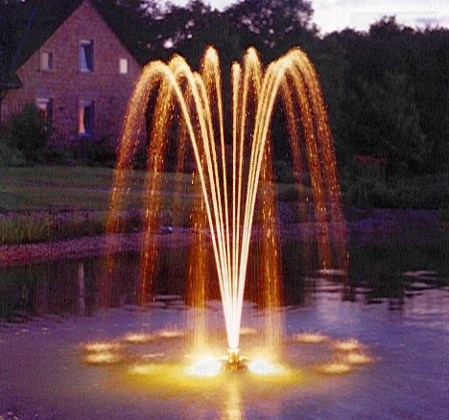
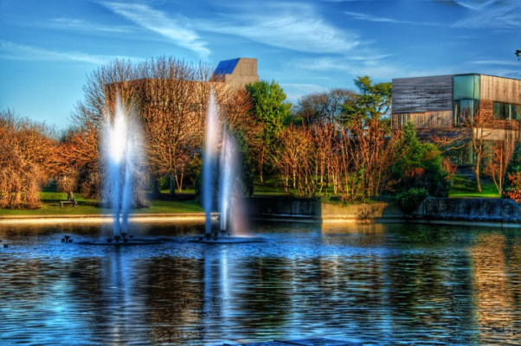
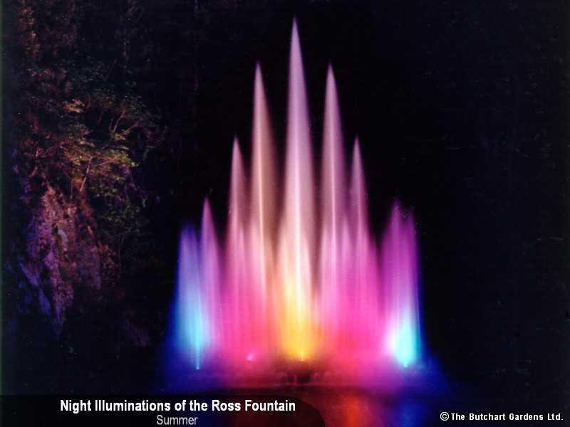
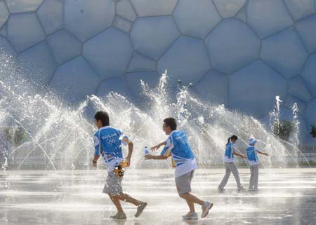
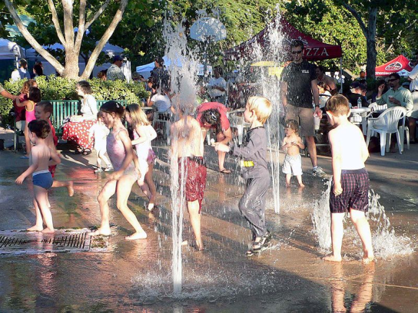
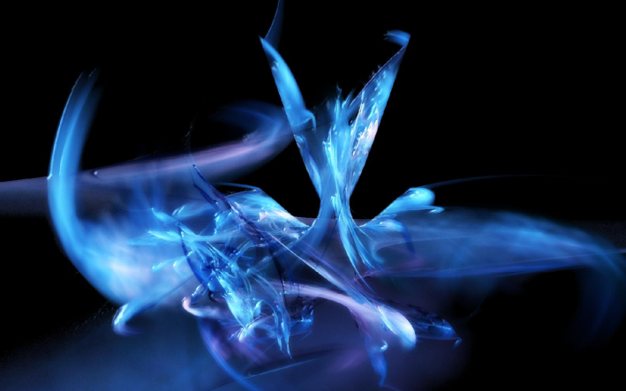
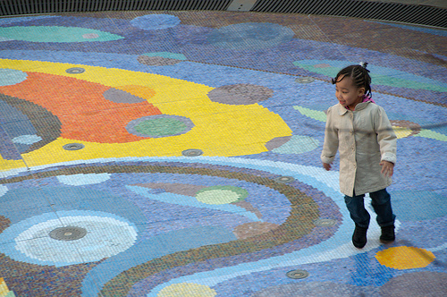
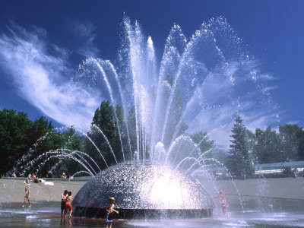
Mood Board
Notes:
Created mood board to help us

Slide 16
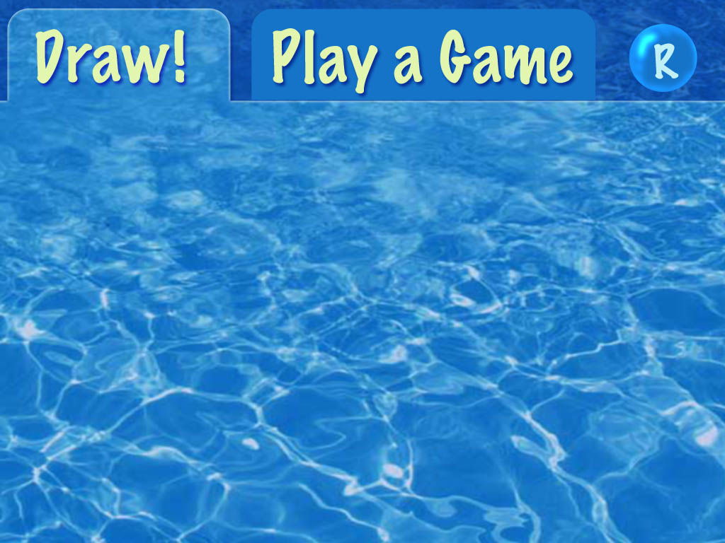
Direct Draw & Games
Notes:
When you’re far away shows visual representation of fountain
In prox trigger direct draw
Can play games – some unlock when its dark or there are enough people

Slide 17
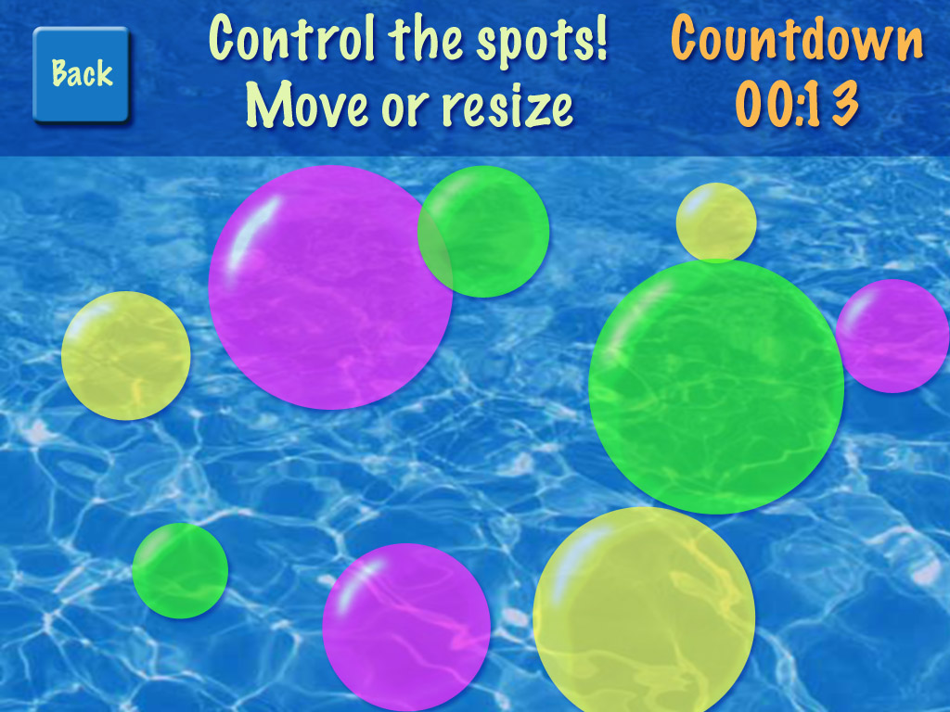
Musical Spots

Slide 18
Concerts

Slide 19
Video Sketch

